Slide 1
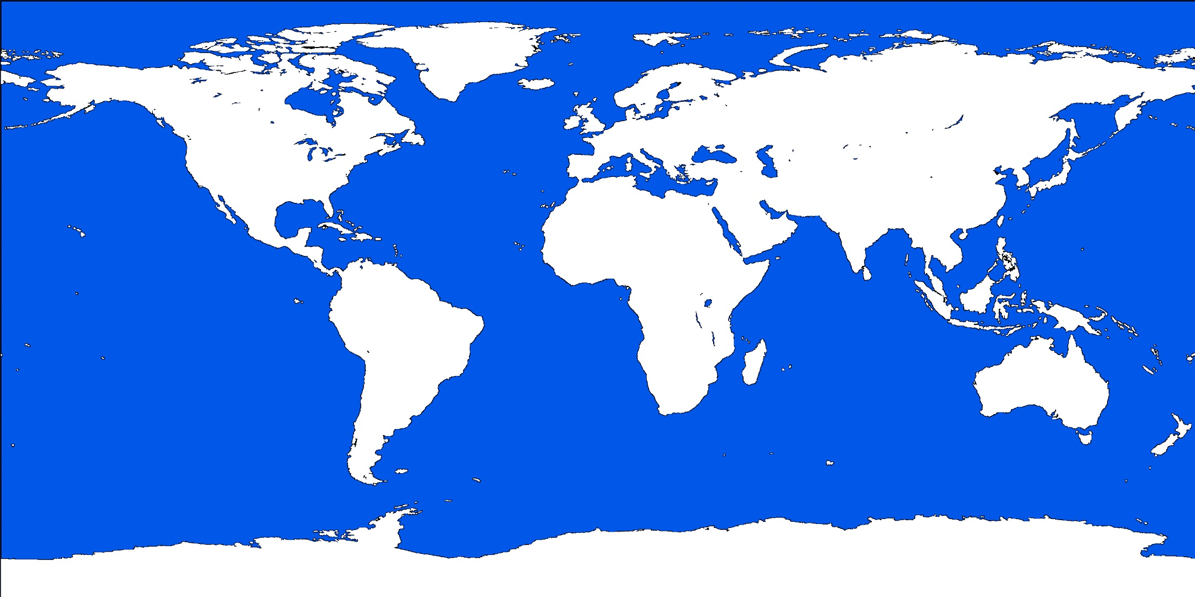
LUOV and Rainbow

Slide 2
LUOV
Based on the oil-vinegar signature scheme
Algebraically, LUOV is basically the same as UOV, which has been studied since 1998
Introduces a new “field lifting” modification that is original and exciting, but unstudied
Round 2 version incorporates random salts and randomizes vinegar variable selection
Still maintains a message recovery mode

Slide 3
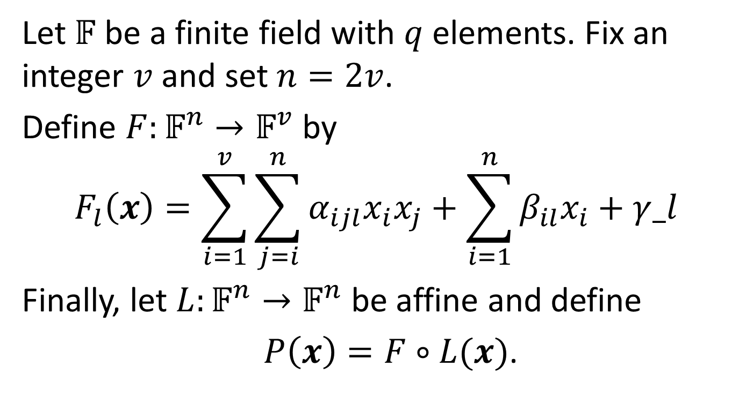
Oil-Vinegar
Let $𝔽$ be a finite field with $q$ elements. Fix an integer $v$ and set $n=2v$.
Define $F:𝔽^{n}→𝔽^{v}$ by
$$F_{l}\left(x\right)=\sum_{i=1}^{v}{\sum_{j=i}^{n}{α_{ijl}x_{i}x_{j}+\sum_{i=1}^{n}{β_{il}x_{i}+γ_l}}}$$
Finally, let $L:𝔽^{n}→𝔽^{n}$ be affine and define
$P\left(x\right)=F∘L(x)$.

Slide 4

Structure of Quadratic Forms
$F_{l}=\left[\begin{matrix}\begin{matrix}α_{11l} & ⋯ & α_{1vl} \\ ⋮ & ⋱ & ⋮ \\ α_{1vl} & ⋯ & α_{vvl}\end{matrix} & \begin{matrix}α_{1\left(v+1\right)l} & ⋯ & α_{1nl} \\ ⋮ & ⋱ & ⋮ \\ α_{v\left(v+1\right)l} & ⋯ & α_{vn1}\end{matrix} \\ \begin{matrix}α_{1\left(v+1\right)l} & ⋯ & α_{v\left(v+1\right)l} \\ ⋮ & ⋱ & ⋮ \\ α_{1nl} & ⋯ & α_{vnl}\end{matrix} & \begin{matrix} 0 & ⋯ & 0 \\ ⋮ & ⋱ & 0 \\ 0 & ⋯ & 0\end{matrix}\end{matrix}\right]$

Slide 5
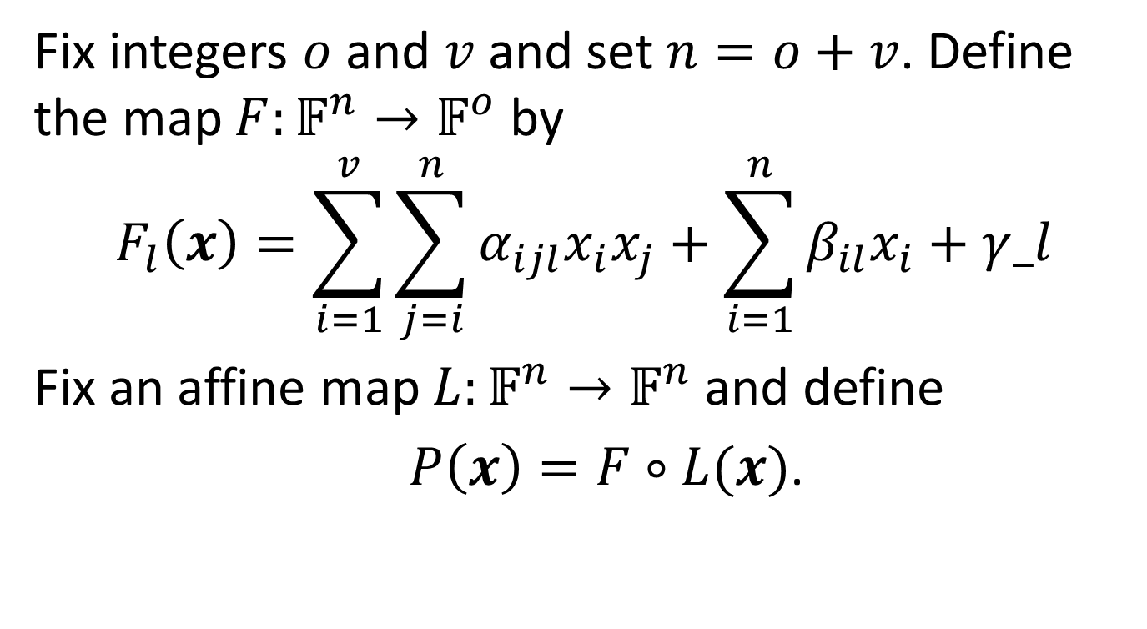
Unbalanced Oil-Vinegar (UOV)
Fix integers $o$ and $v$ and set $n=o+v$. Define the map $F:𝔽^{n}→𝔽^{o}$ by
$$F_{l}\left(x\right)=\sum_{i=1}^{v}{\sum_{j=i}^{n}{α_{ijl}x_{i}x_{j}}}+\sum_{i=1}^{n}{β_{il}x_{i}}+γ_l$$
Fix an affine map $L:𝔽^{n}→𝔽^{n}$ and define
$P\left(x\right)=F∘L(x)$.

Slide 6
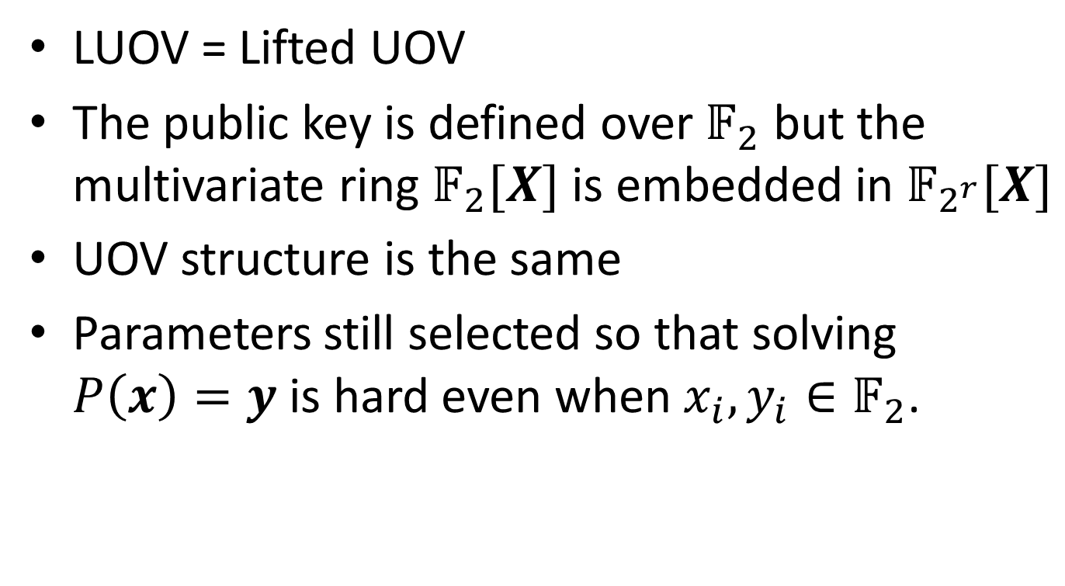
Field Lifting
LUOV = Lifted UOV
The public key is defined over $𝔽_{2}$ but the multivariate ring $𝔽_{2}[X]$ is embedded in $𝔽_{2^{r}}[X]$
UOV structure is the same
Parameters still selected so that solving $P\left(x\right)=y$ is hard even when $x_{i}, y_{i}∈𝔽_{2}$.

Slide 7
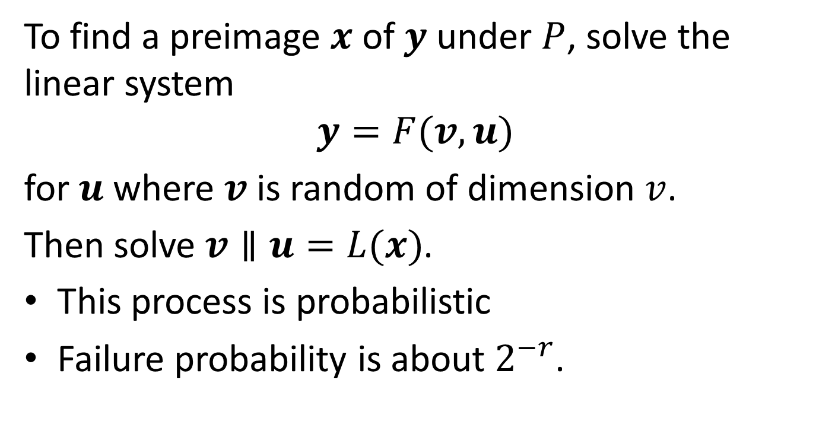
Inversion of the Central Map
To find a preimage $x$ of $y$ under $P$, solve the linear system
$$y=F(v,u)$$
for $u$ where $v$ is random of dimension $v$.
Then solve $v∥u=L(x)$.
This process is probabilistic
Failure probability is about $2^{−r}$.

Slide 8
On Side-Channel Leakage
Claim that constant-timeness of AVX2 implementation is “verified” by a couple of tools, Valgrind and dudect
Admit that the Valgrind test fails specifically by leaking number of signing attempts made
No direct leakage of secret information

Slide 9
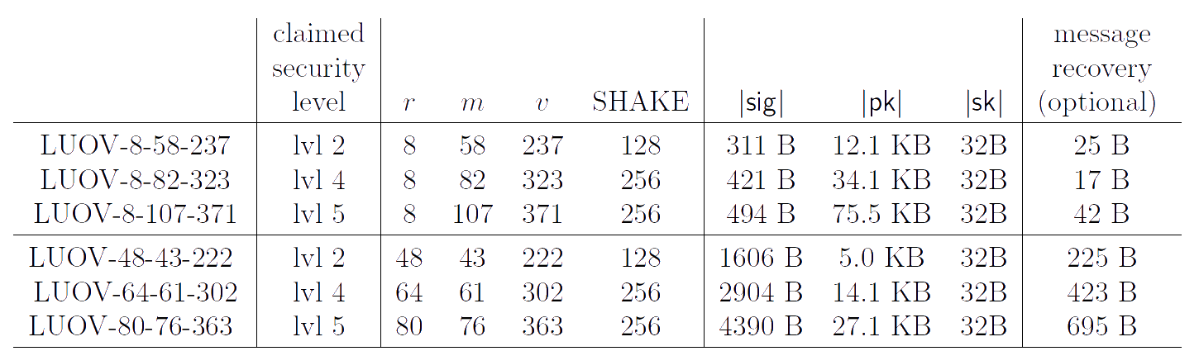
LUOV Parameter Sets

Slide 10
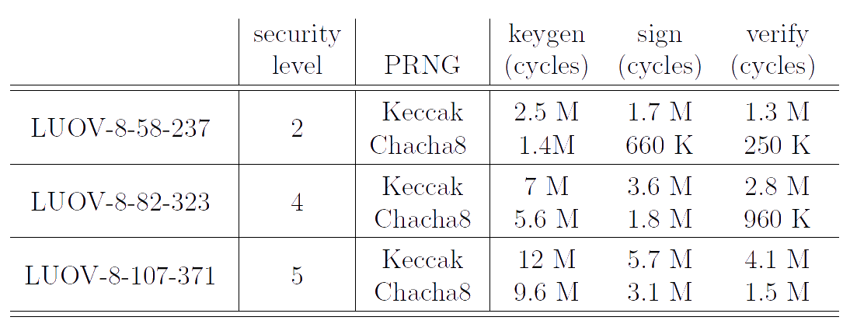
AVX2 Optimized Performance

Slide 11
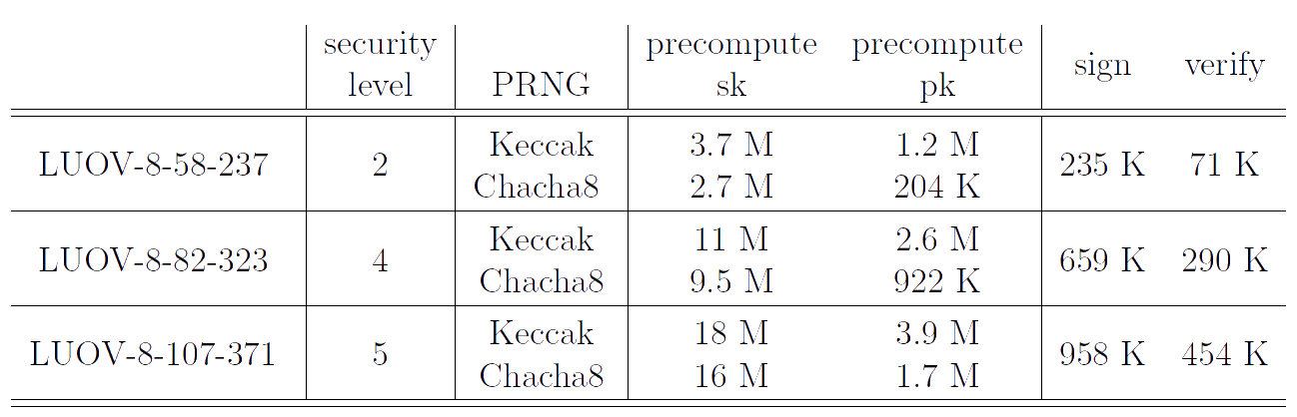
AVX2 Performance w/ Precomputation

Slide 12
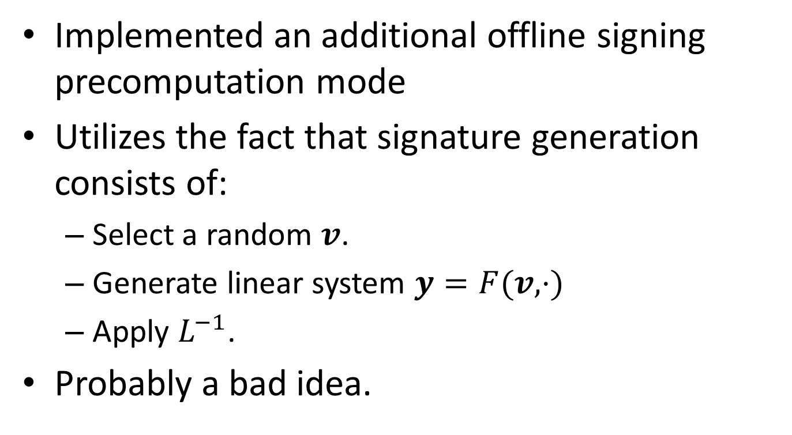
Offline Signing Precomputation
Implemented an additional offline signing precomputation mode
Utilizes the fact that signature generation consists of:
  Select a random $v$.
  Generate linear system $y=F(v, ⋅)$
  Apply $L^{−1}$.
Probably a bad idea.

Slide 13
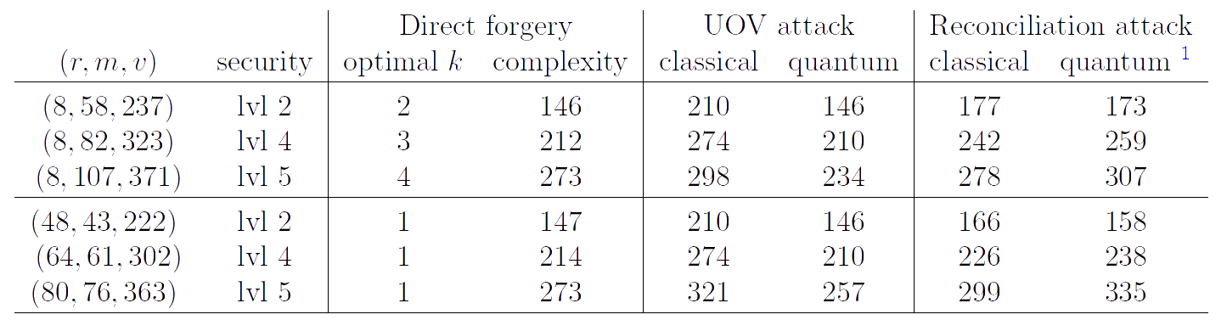
Security Analyses

Slide 14
Changes from Round 1
Smaller security margin. They say they were too conservative in Round 1
Includes the random “salt” to avoid fault-injection attacks.
Chooses Vinegar variables randomly instead of deterministically (for side-channel resistance and offline capabilities.)
Includes a ChaCha8 option

Slide 15
Rainbow Round 2
Also based on UOV
First proposed in 2004 with parameters that we too aggressive
Threads two (or more) UOV instances in a way that improves efficiency but maintains the algebraic complexity
Introduces new rank-based attack paths, but tunes parameters to account for their complexity

Slide 16
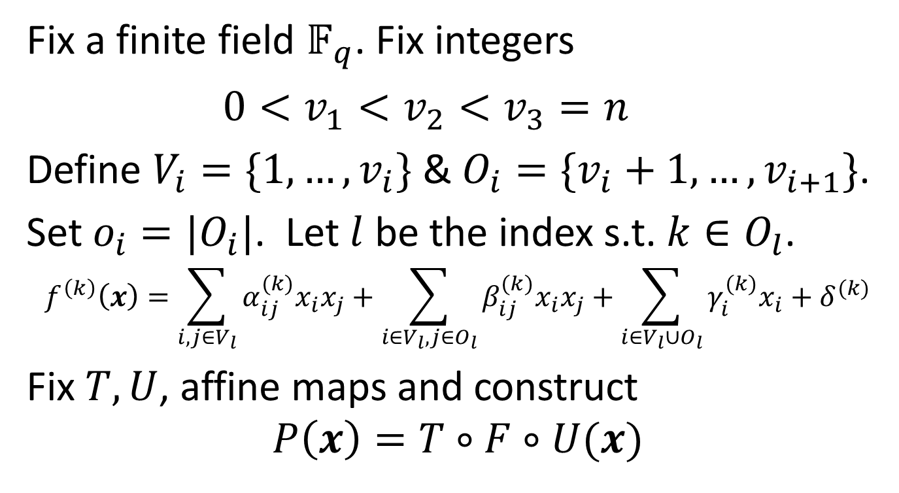
Rainbow map
Fix a finite field $𝔽_{q}$. Fix integers
$0<v_{1}<v_{2}<v_{3}=n$
Define $V_{i}=\{1,…,v_{i}\}$ & $O_{i}=\{v_{i}+1,…,v_{i+1}\}$.
Set $o_{i}=|O_{i}|$. Let $l$ be the index s.t. $k∈O_{l}$.
$$f^{\left(k\right)}\left(x\right)=\sum_{i,j∈V_{l}}{α_{ij}^{(k)}x_{i}x_{j}}+\sum_{i∈V_{l},j∈O_{l}}{β_{ij}^{(k)}x_{i}x_{j}}+\sum_{i∈V_{l}∪O_{l}}{γ_{i}^{(k)}x_{i}}+δ^{(k)}$$
Fix $T,U$, affine maps and construct
$$P\left(x\right)=T∘F∘U(x)$$

Slide 17
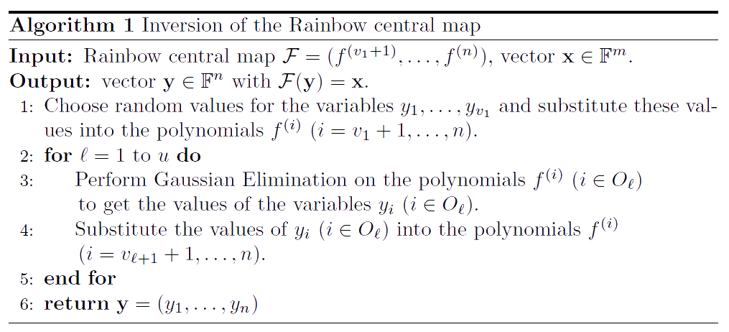
Rainbow map Inversion

Slide 18
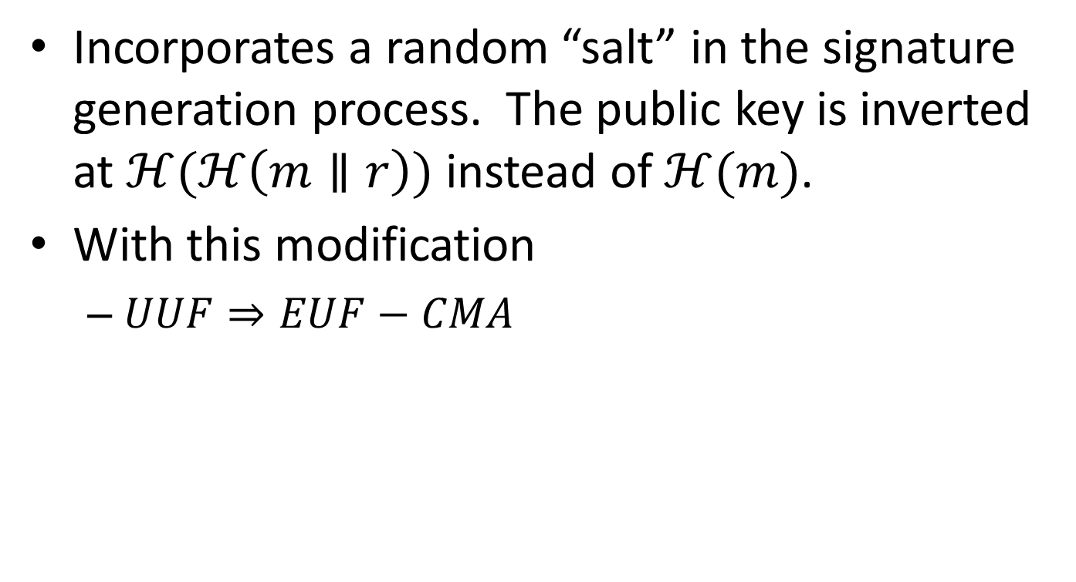
EUF-CMA Security
Incorporates a random “salt” in the signature generation process. The public key is inverted at $ℋ(ℋ\left(m∥r\right))$ instead of $ℋ(m)$.
With this modification
  $UUF⇒EUF−CMA$

Slide 19
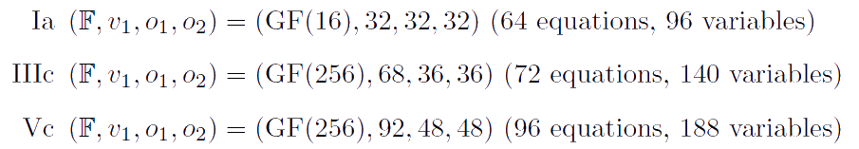
Rainbow Setup Parameters

Slide 20
New Variants
cyclicRainbow
  Not actually cyclic, but pseudorandom (not sure why they named it cyclic, exactly.)
  About 70% smaller keys, but significantly slower verification.
compressedRainbow
  Another variant that also pseudorandomly generates a portion of the private key
We basically asked for these.

Slide 21
Addressing Constant-Timeness
Use logarithm and exponential tables for multiplication with a large negative log for 0 to achieve constant-time implementations over GF(16).
For GF(256) they represent elements as degree one polynomials over GF(16) and bootstrap the GF(16) trick.

Slide 22
Constant-Time Gaussian Elimination
The pivot value is used as a conditional for switching rows and is switched with every row containing a no-zero value.
Is slower than standard Gaussian elimination by 50% (GF(16)) and 100% (GF(256)).

Slide 23
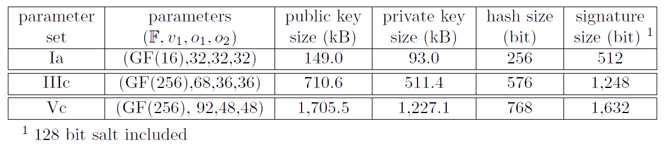
Rainbow Parameters

Slide 24
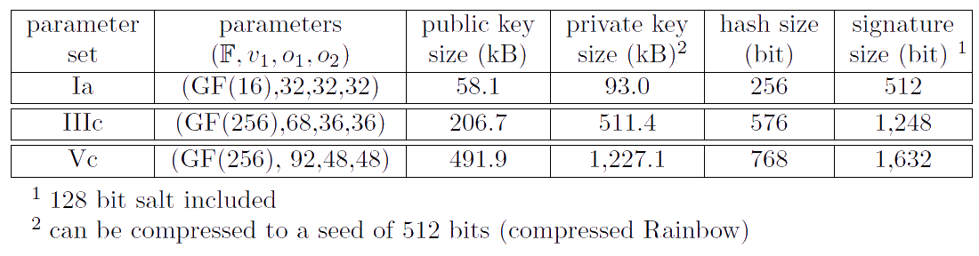
cyclic/compressedRainbow Parameters

Slide 25
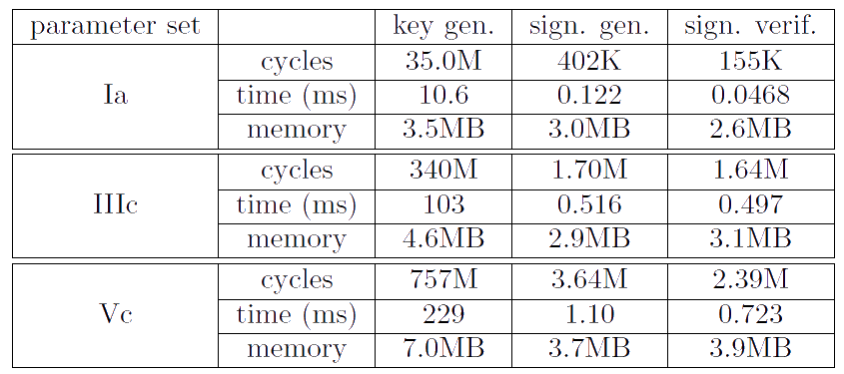
Rainbow Performance

Slide 26
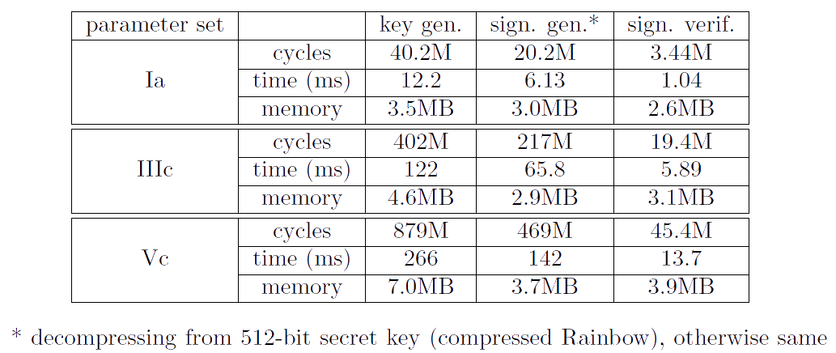
cyclic/compressedRainbow Performance

Slide 27
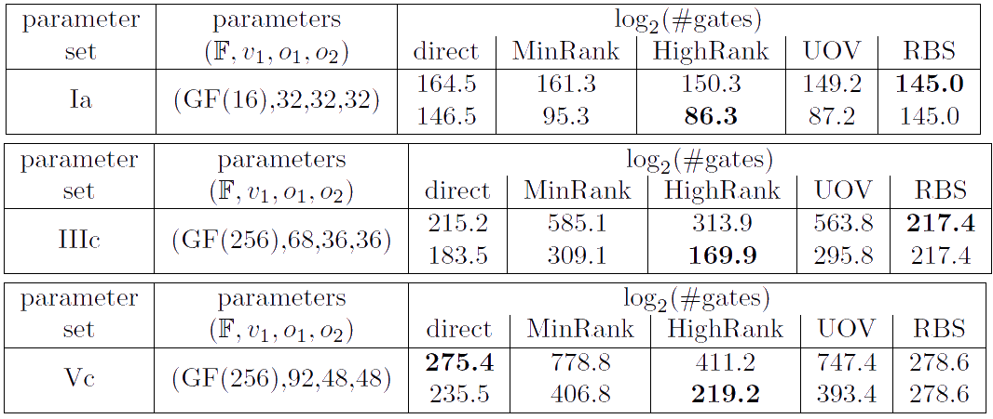
Security Against Known Attacks

Slide 28
Changes From Round 1
Improved Key Generation. Basically the direct analogue of what LUOV does. (Ironic since the argument for this technique provided in Round 1 LUOV comes from the principal submitter of Rainbow which didn’t do it in round 1.)
More focused set of parameters (3 vs. 11ish)
Cyclic and compressed versions we asked for

